Slide 1
Lab 11. Astable Multivibrator
4001 circuit: Quad 2-input NOR gate
14
13
12
11
10
9
8
Notch
1
2
3
4
5
6
7
Correct direction

Slide 2
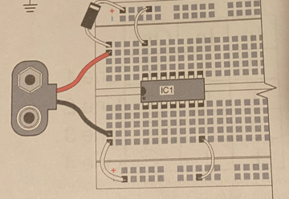
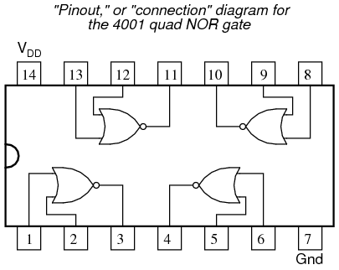
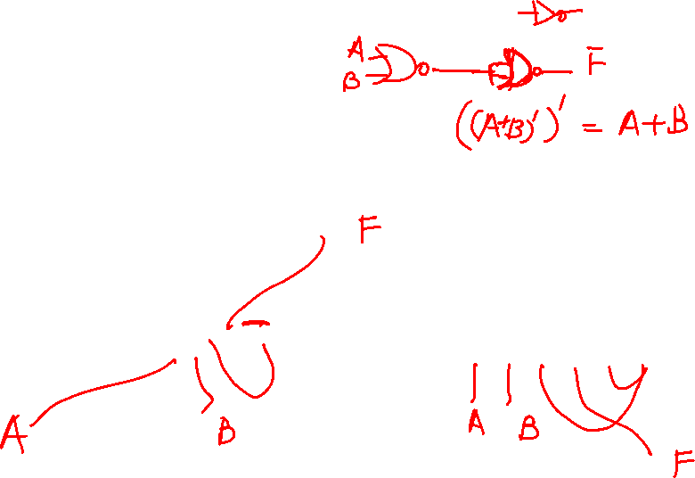
Warm-up: OR gate
Make connections

Slide 3
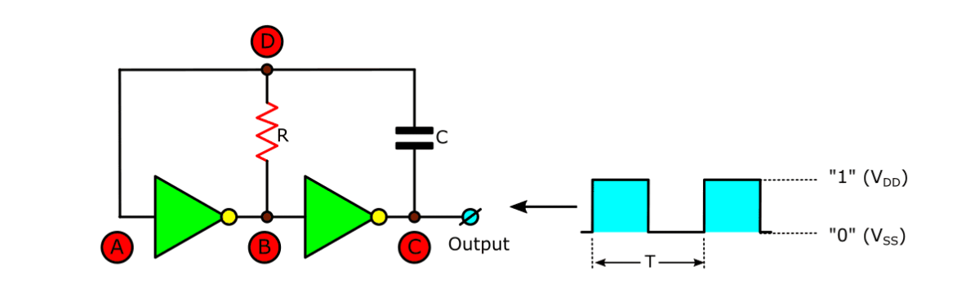
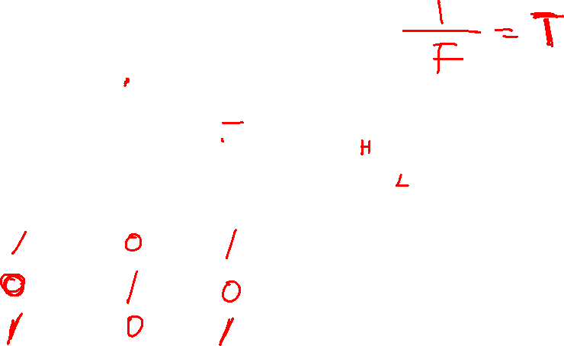

Slide 4


The frequency of the clock signal
F = $\frac{1}{1.4R_{1}C_{1}}$

Slide 5
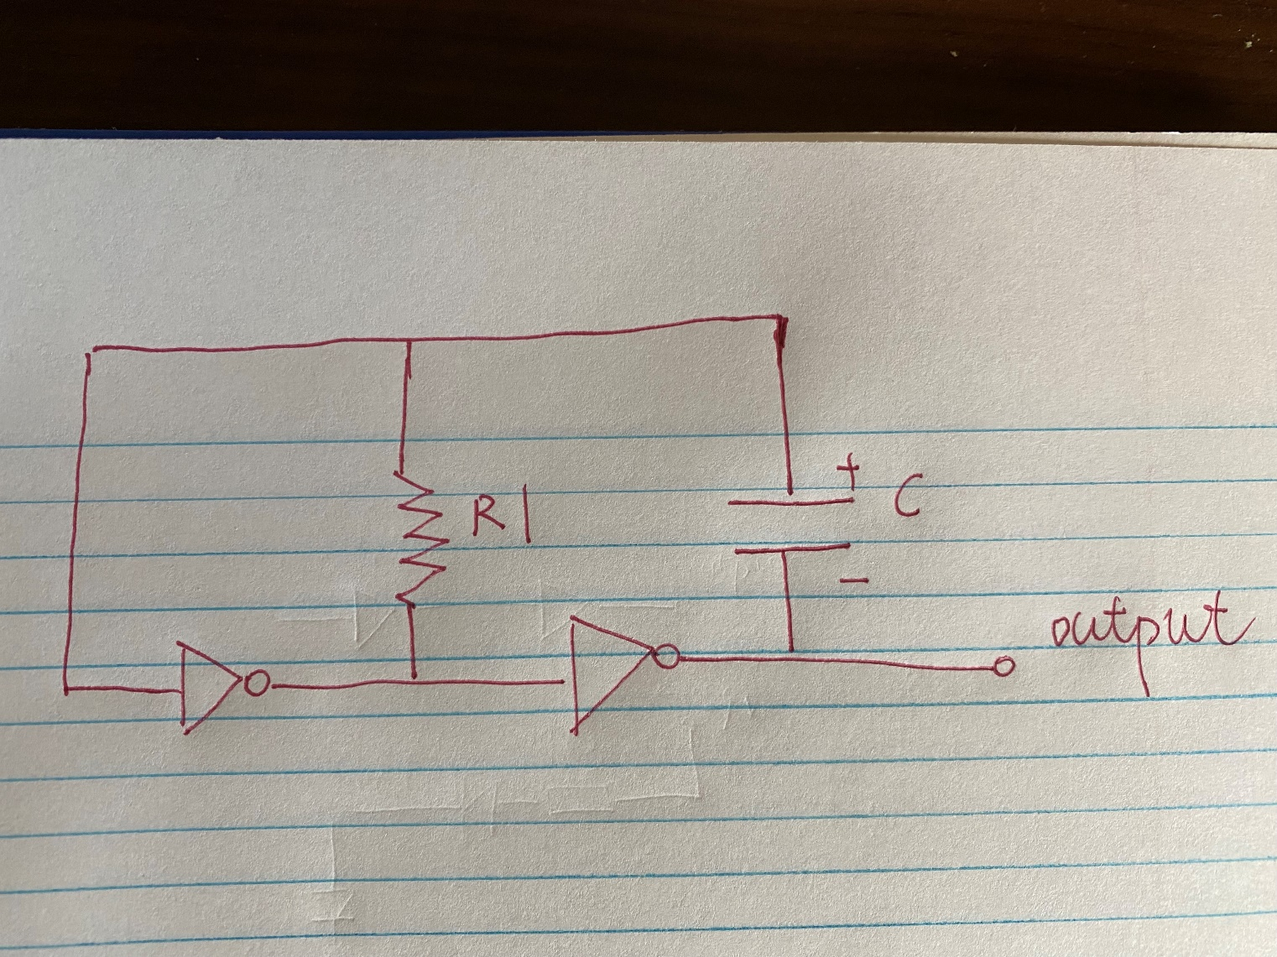


Slide 6
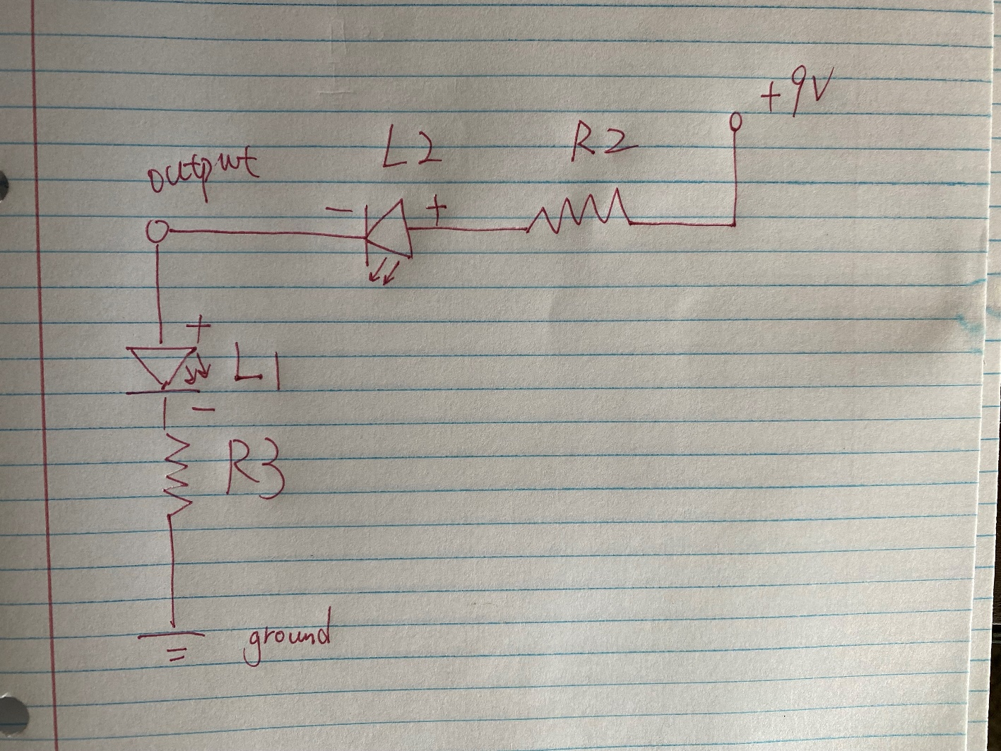
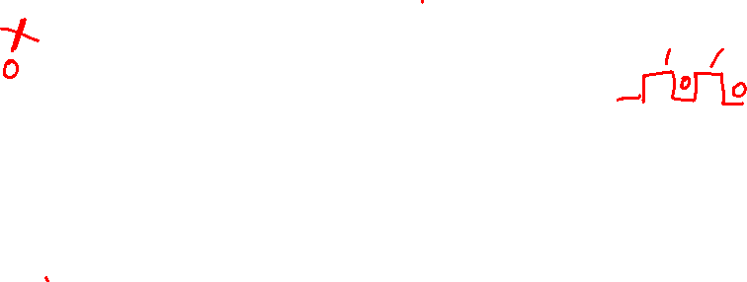

Slide 7
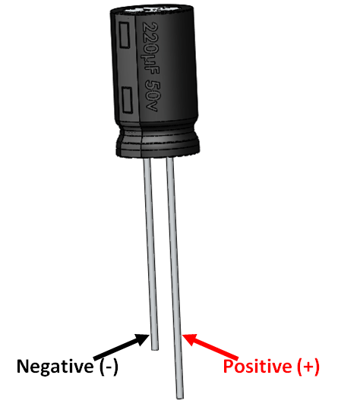

Components:
Two LEDs(red and green)
R1 (determine the value)
R2 and R3 1KΩ resistor(brown, black, red)
4001 IC
10uF capacitor

Slide 8
Sketch the connection either on slides or on a paper and let me check it.
Calculate the resistance of R1, the period of clock signal is 0.952 second.
Make the connections on the breadboard.
Notice: When using 4001 IC, don’t forget to connection pin 14 to battery and pin 7 to ground.

